Slide 1
A Comparison of
Two Flux Tower Stations
at Sedgwick Reserve
GEOG 136
Rachel Green
May 17, 2019

Slide 2
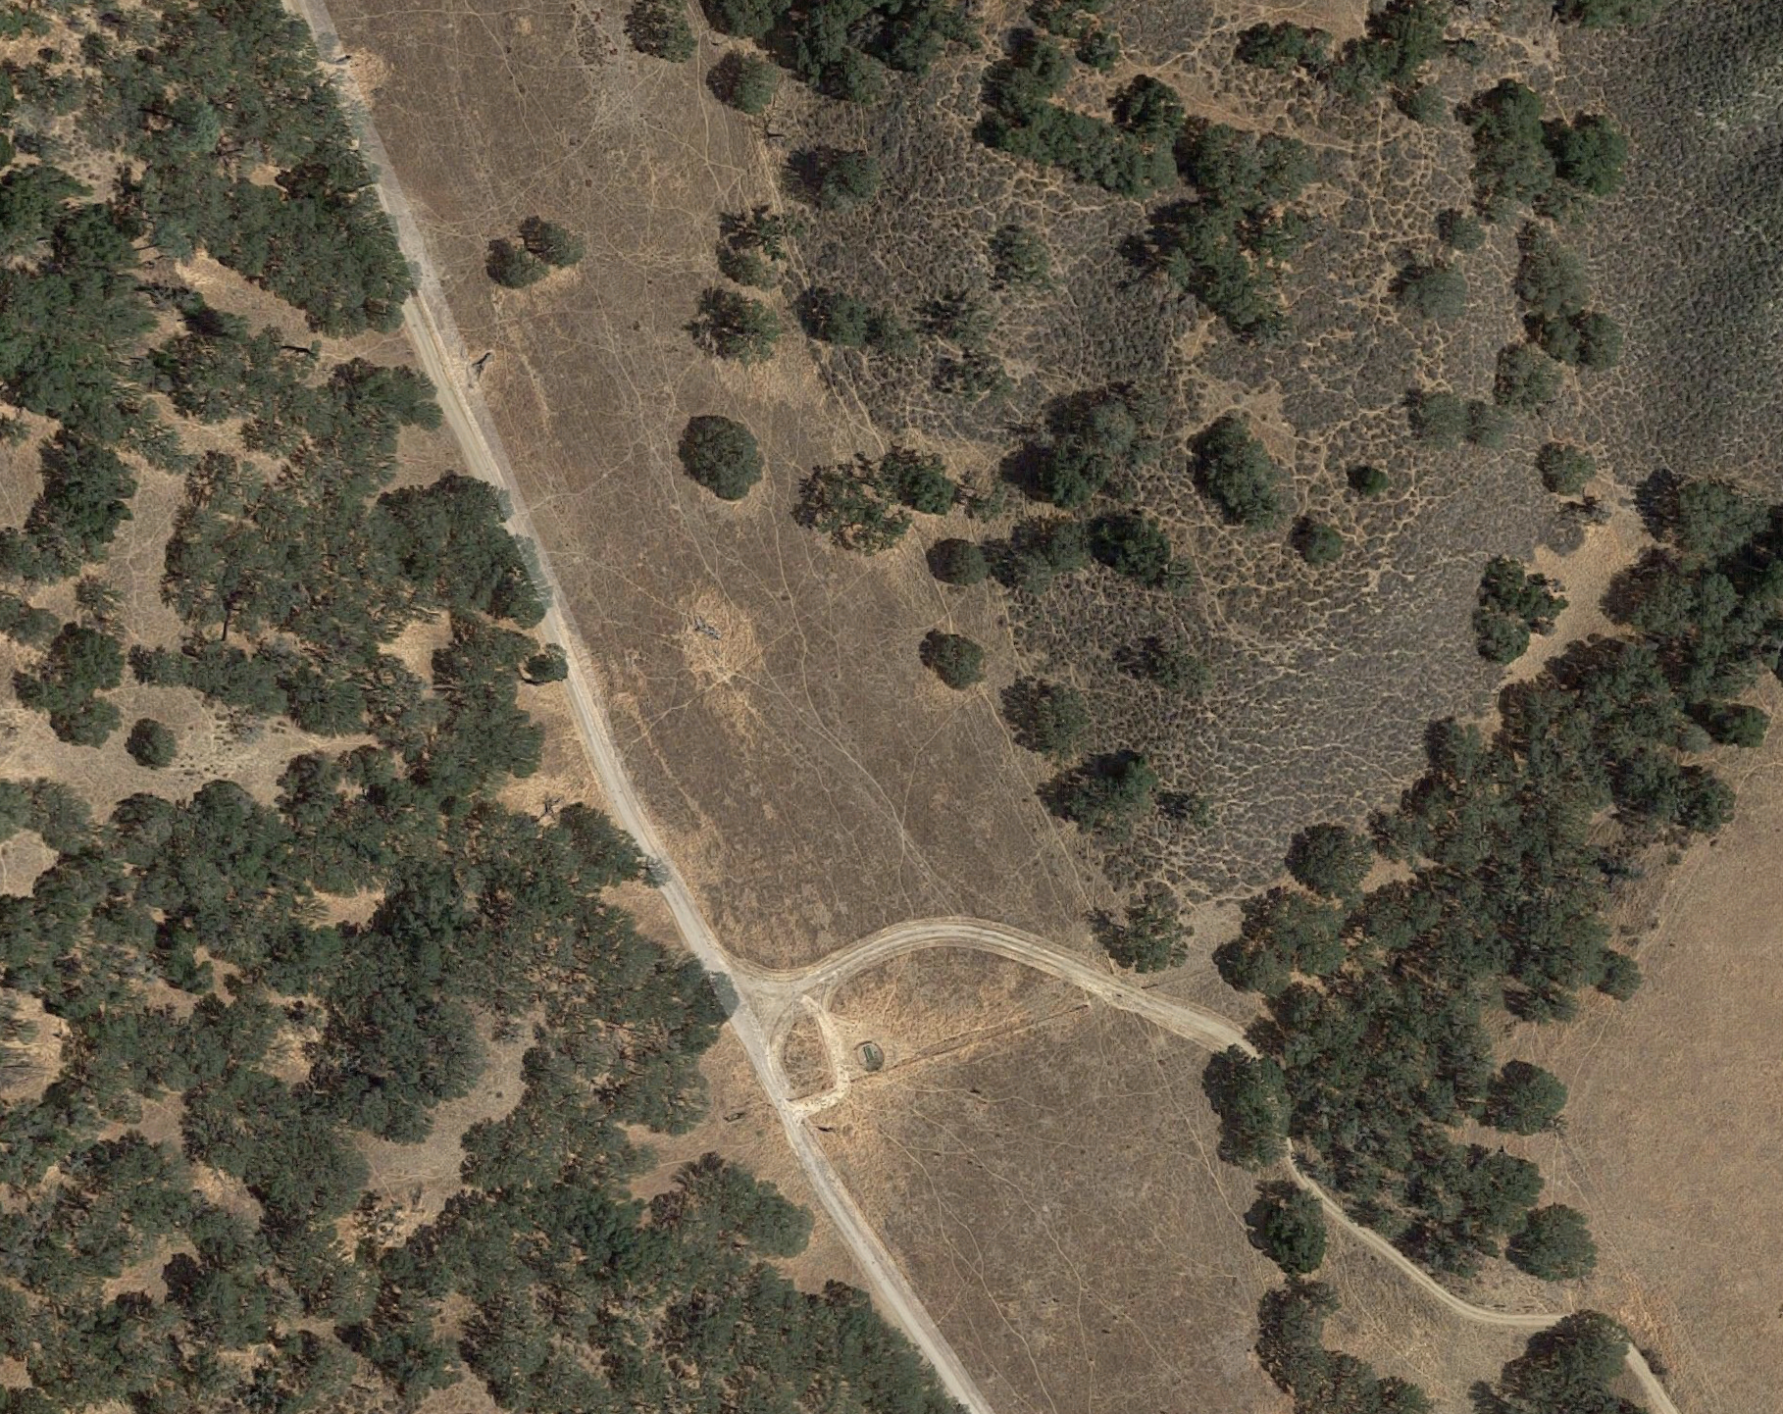
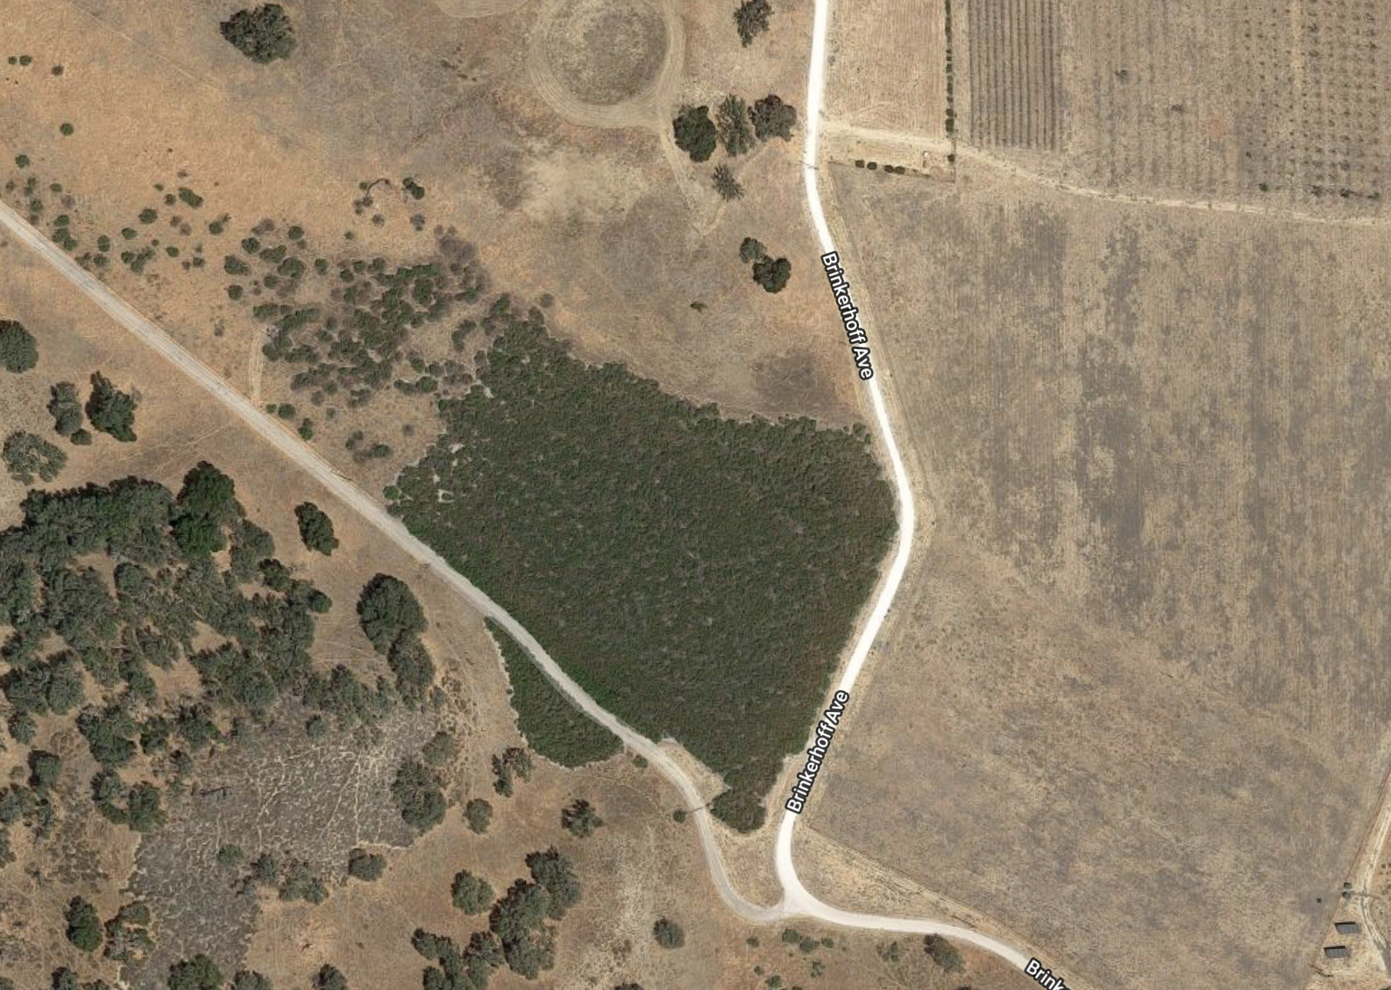

Slide 3
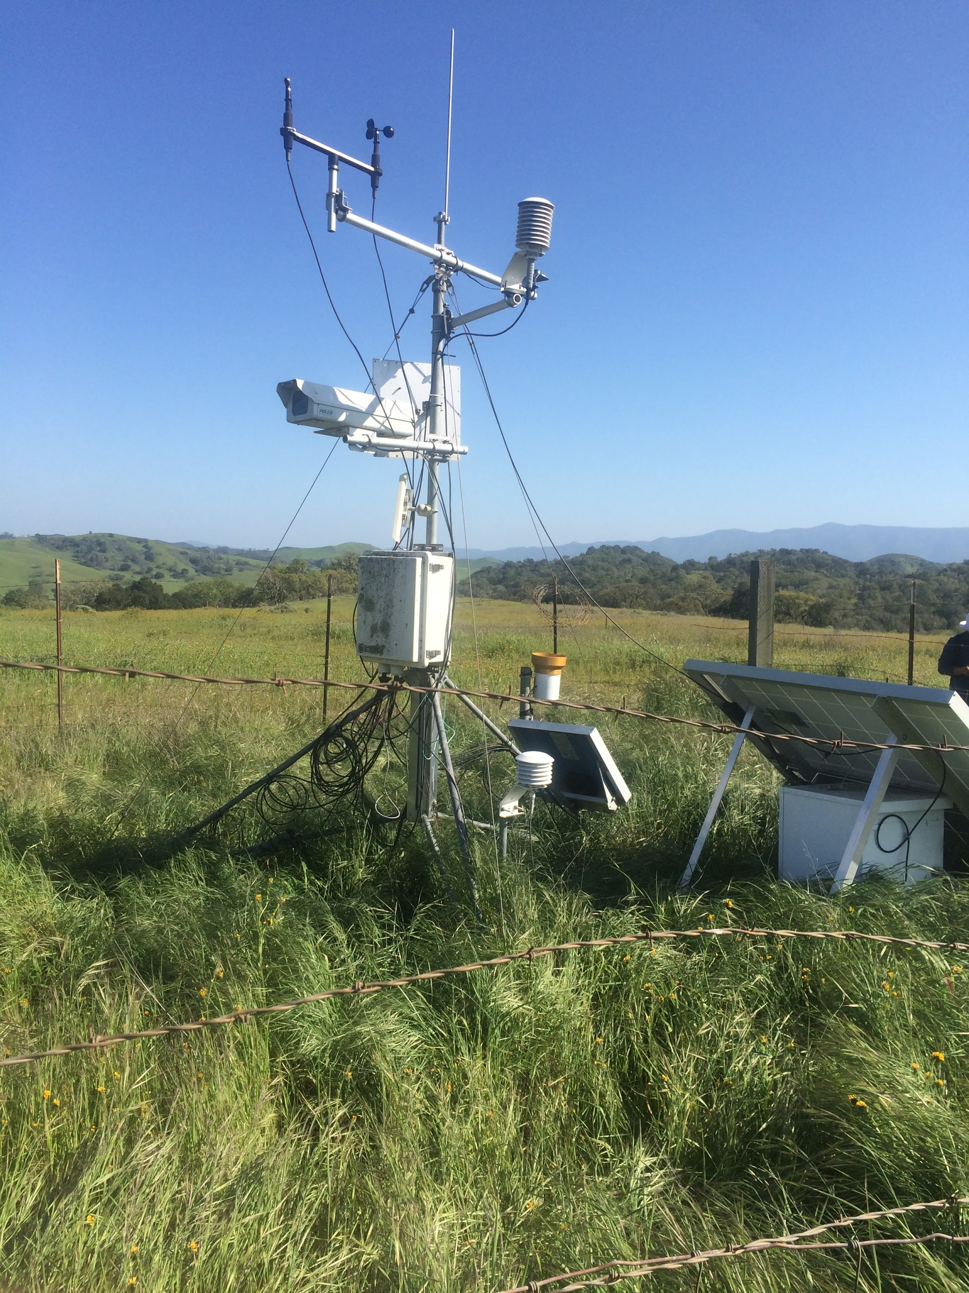
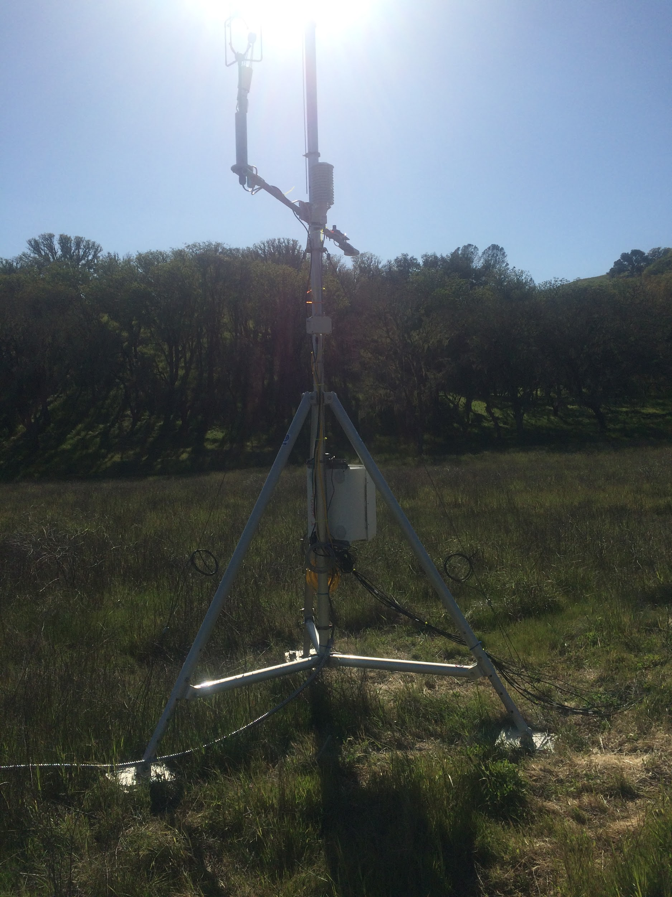

Slide 4
Flux Tower Data Organization
Raw data fed through Eddypro (.ghg files)
Output files:
Full output * Primary results file
AmeriFlux results
GHG-Europe results
Biomet measurements
Spectral Outputs
(co)spectra and ogives (cumulative frequency)
Cospectra with the vertical wind component, calculated for each variable for each flux averaging interval
Processed raw data
Statistics - mean, variance, covariance, Skewness, Kurtosis
Time Series
Variables

Slide 5
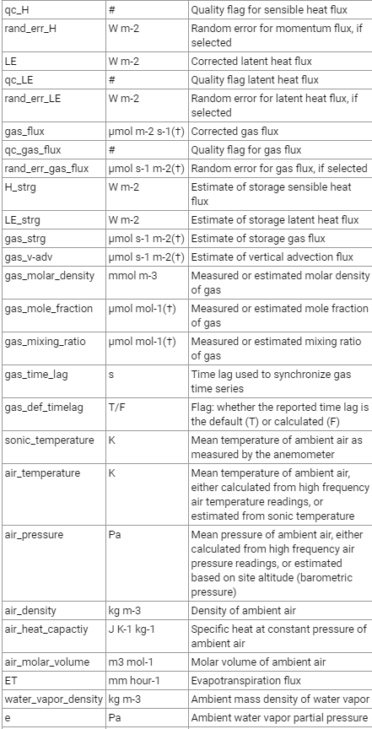
Full Output
Fluxes
Quality flags
Micrometeorological variables
Gas concentrations and densities
Footprint estimations
Diagnostic information
Ancillary variables

Slide 6
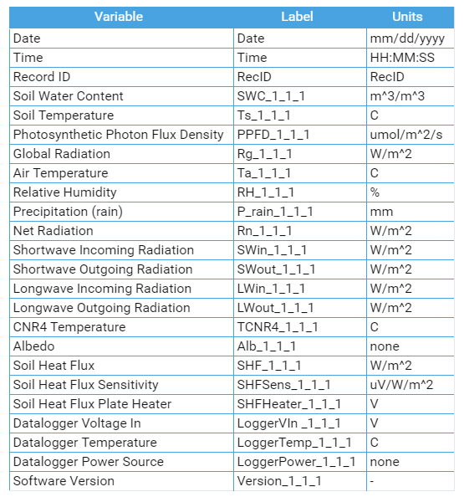
Biomet Data
Biomet system records data from meteorological sensors on an eddy covariance system
Variable labels in header can include as a suffix the “location qualifier” - X_Y_Z
Tells you the location of the instrument/sensor on the tower
Can then get the height at which the variable was measured and compare differences

Slide 7
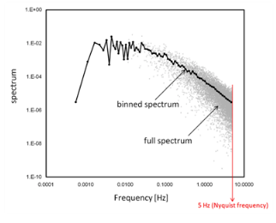
Spectra, Cospectra, Ogives
Spectra available for three wind components, sonic temperature, gas concentrations or densities
Cospectra for covariances of w (vertical wind component) and all other variables
Calculated for each flux averaging period and contain and number of frequencies equal to half the number of raw records

Slide 8
Cleaning the Data
Read in data
Parse dates - date and time
Format (ex. Y-m-d H:M)
Convert time zone from UTC to PST
Pytz
Separate time and date again for plotting
Time Zone Change:
pacific = pytz.timezone('US/Pacific')
coyote_full['DATE'].dt.tz_localize("GMT").dt.tz_convert('America/Los_Angeles').dt.tz_localize(None))

Slide 9
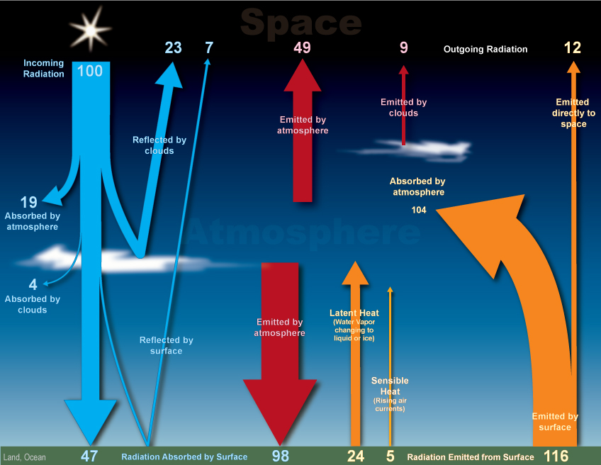
Latent heat - the energy released or taken up per unit mass by a system in changing phase
Sensible heat - that heat (energy) able to be sensed (e.g. with a thermometer)

Slide 10
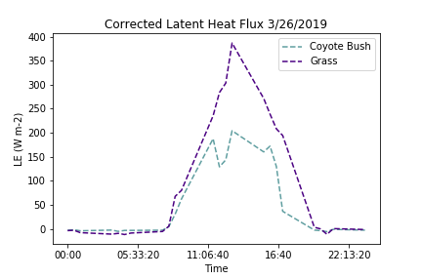
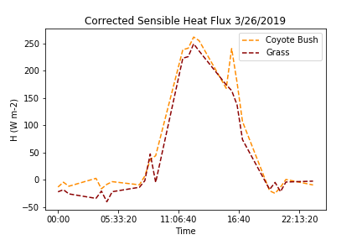

Slide 11
Two sample Independent t-test
alpha = 0.05
t_stat, df, cv, p = independent_ttest(coyote_full.H[60:72], grass_full.H[53:72], alpha)
print('t=%.3f, df=%d, cv=%.3f, p=%.3f' % (t_stat, df, cv, p))
# interpret via critical value
if abs(t_stat) <= cv:
print('Accept null hypothesis that the means are equal.')
else:
print('Reject the null hypothesis that the means are equal.')
# interpret via p-value
if p > alpha:
print('Accept null hypothesis that the means are equal.')
else:
print('Reject the null hypothesis that the means are equal.')
Latent Heat T-test output
t=1.975, df=29, cv=1.699, p=0.058
Critical value:
Reject the null hypothesis that the means are equal.
P-value:
Accept null hypothesis that the means are equal.
*Ultimately look at the figure, absolute difference in means and use your own judgement!

Slide 12
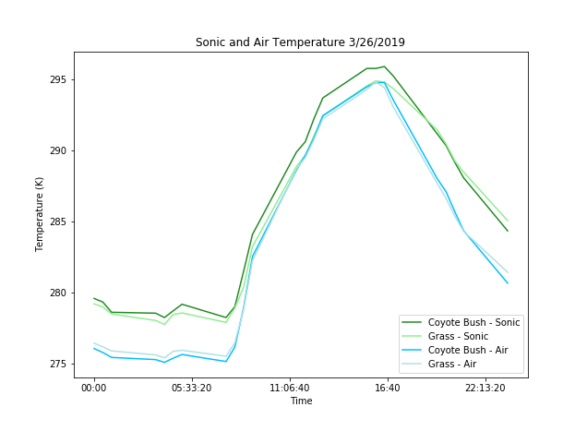

Slide 13
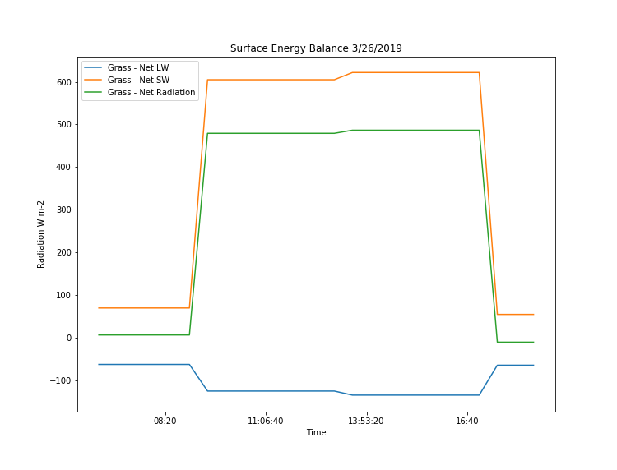
Surface Energy Balance

